Slide 1
Estimating LLMs’
Resource Requirement
Source:
* Transformers Math 101: https://eleutherai.notion.site/Transformers-Math-101-d2fcfc7a25d446388fde97821ad2412a

Slide 2
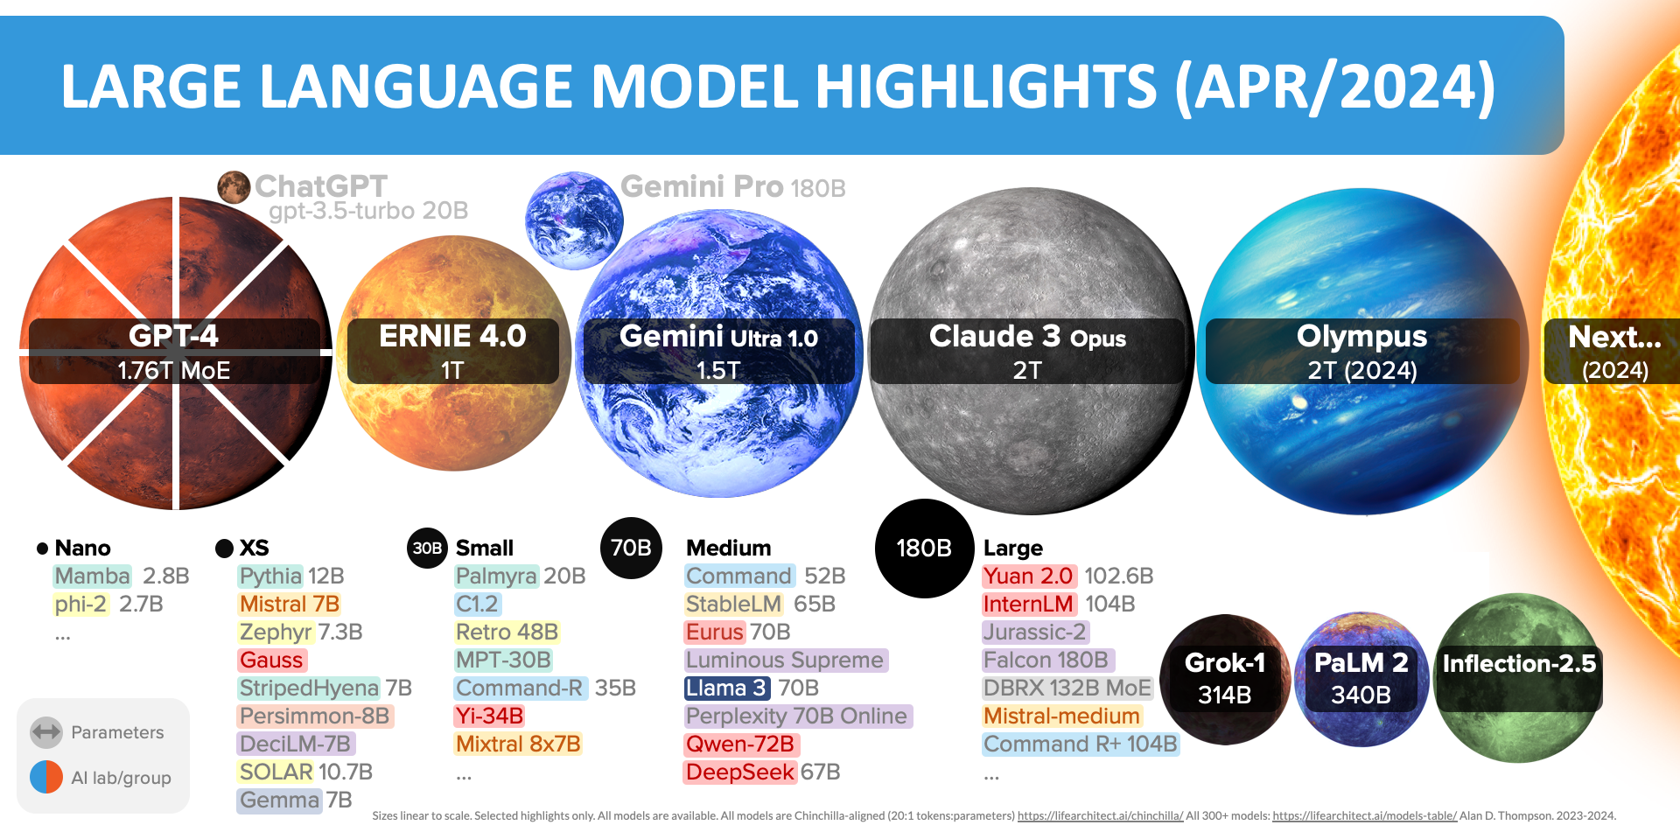
Source: https://lifearchitect.ai/models/
Notes:
ERNIE: Huawei Noah’s Ark Lab
Olympus: Amazon

Slide 3
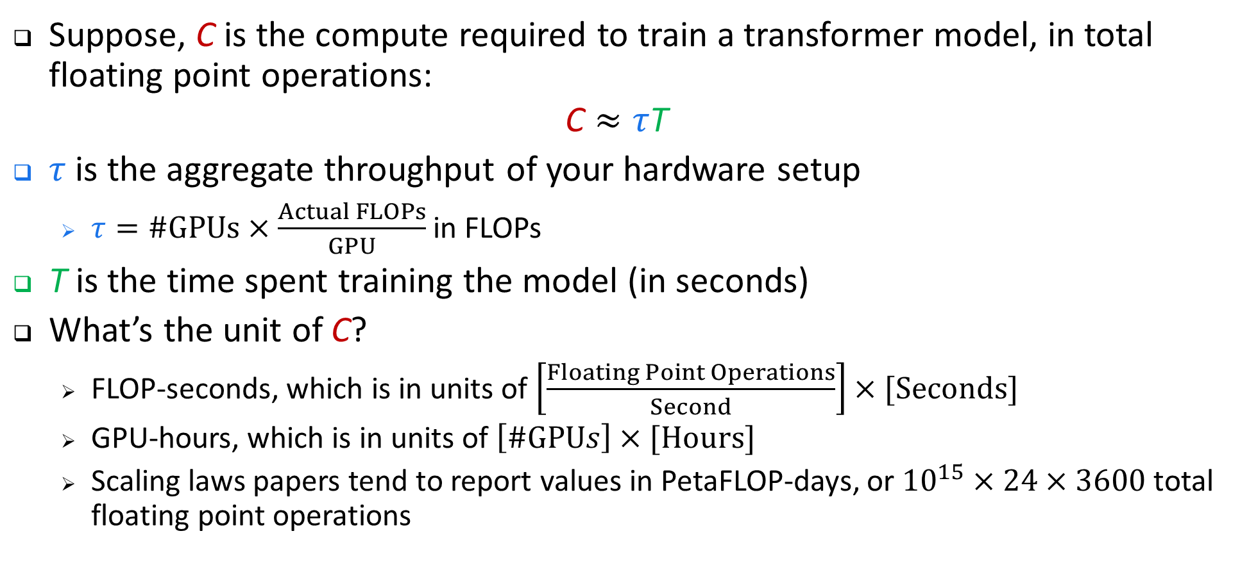
Computation Budget
Suppose, C is the compute required to train a transformer model, in total floating point operations:
$$\text{C}≈τ\text{T}$$
$τ$ is the aggregate throughput of your hardware setup
  $τ=\#GPUs×\frac{Actual FLOPs}{GPU}$ in FLOPs
T is the time spent training the model (in seconds)
What’s the unit of C?
  FLOP-seconds, which is in units of $\left[\frac{Floating Point Operations}{Second}\right]×[Seconds]$
  GPU-hours, which is in units of $\left[\#GPUs\right]×[Hours]$
  Scaling laws papers tend to report values in PetaFLOP-days, or ${10}^{15}×24×3600$ total floating point operations

Slide 4
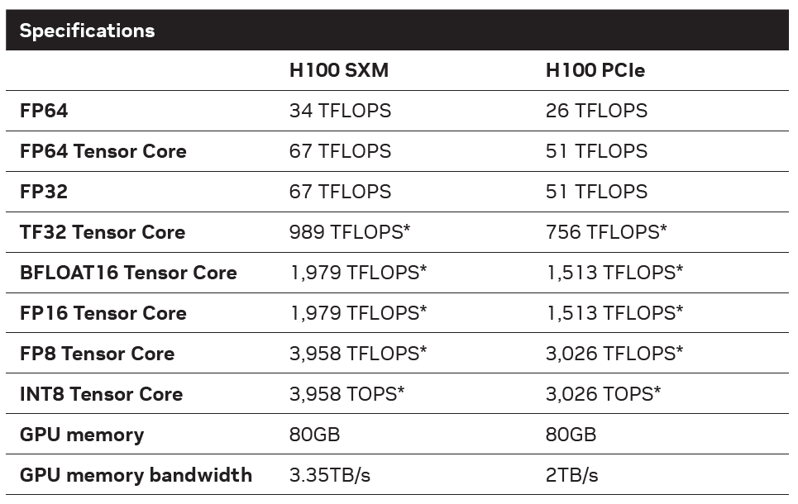
NVIDIA H100 Performance
Note that these FLOPs values are never met in practice
  Especially in a distributed setting!
* Shown with sparsity. Specifications 1/2 lower without sparsity.
Source: NVIDIA H100 Tensor Core GPU datasheet

Slide 5

Computation Budget (cont’d)
$$\text{C}≈τ\text{T} \text{=}\text{ 6}\text{N}\text{D}$$
We can write C as follows:
  $C=C_{forward}+C_{backward}$
    $C_{forward}=2ND$
    $C_{backward}=4ND$
    N is the number of parameters in the transformer model
    D is the dataset size (in tokens)

Slide 6
Large Models’
Memory Requirements

Slide 7
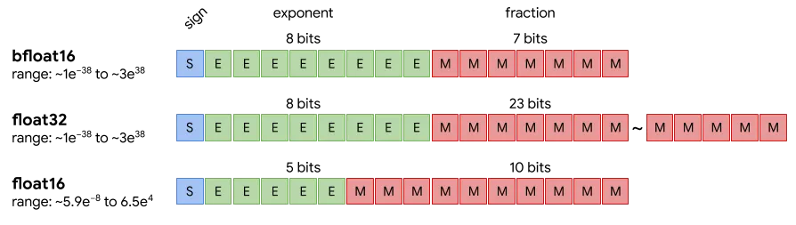
GPU Datatypes: Floating Point

Slide 8
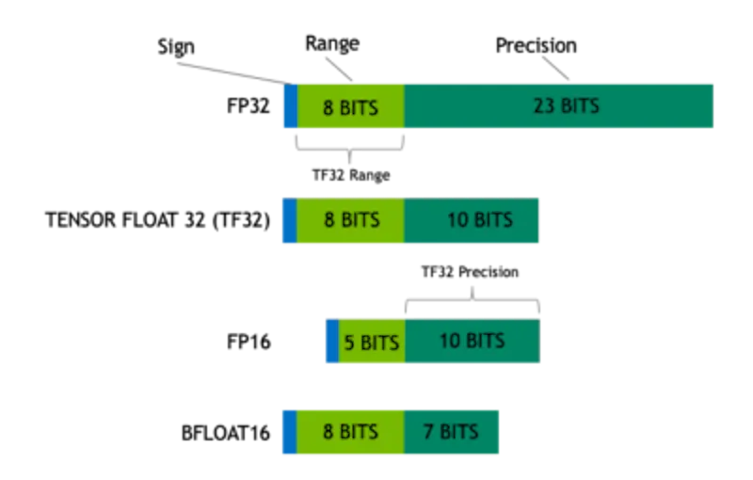
GPU Datatypes: Floating Point (cont’d)
Source: https://blogs.nvidia.com/blog/tensorfloat-32-precision-format/
Notes:
It is technically a 19-bit format. You can treat it as an extended-precision BFLOAT16, say “BFLOAT19" ☺ Or like reduced-precision FP32.

Slide 9
GPU Datatypes:
GPU Architecture | fp32 | fp16 | bf16 | fp8 | int8 | int4
Volta | Y | Y | N | N | Y | Y
Turing | Y | Y | N | N | Y | Y
Ampere | Y | Y | Y | N | Y | Y
Ada-Lovelace | Y | Y | Y | Y | Y | Y
Hopper | Y | Y | Y | Y | Y | Y
Volta (datacenter): V100
Turing (consumer): 2000-series
Ampere (consumer/datacenter): 3000-series & A100
Ada-Lovelace (consumer/datacenter): 4000-series
Hopper (datacenter): H100 and H200
Notes:
Volta (datacenter): V100
Turing (consumer): 2000-series
Ampere (consumer/datacenter): 3000-series & A100
Ada-Lovelace (consumer/datacenter): 4000-series
Hopper (datacenter): H100 and H200

Slide 10
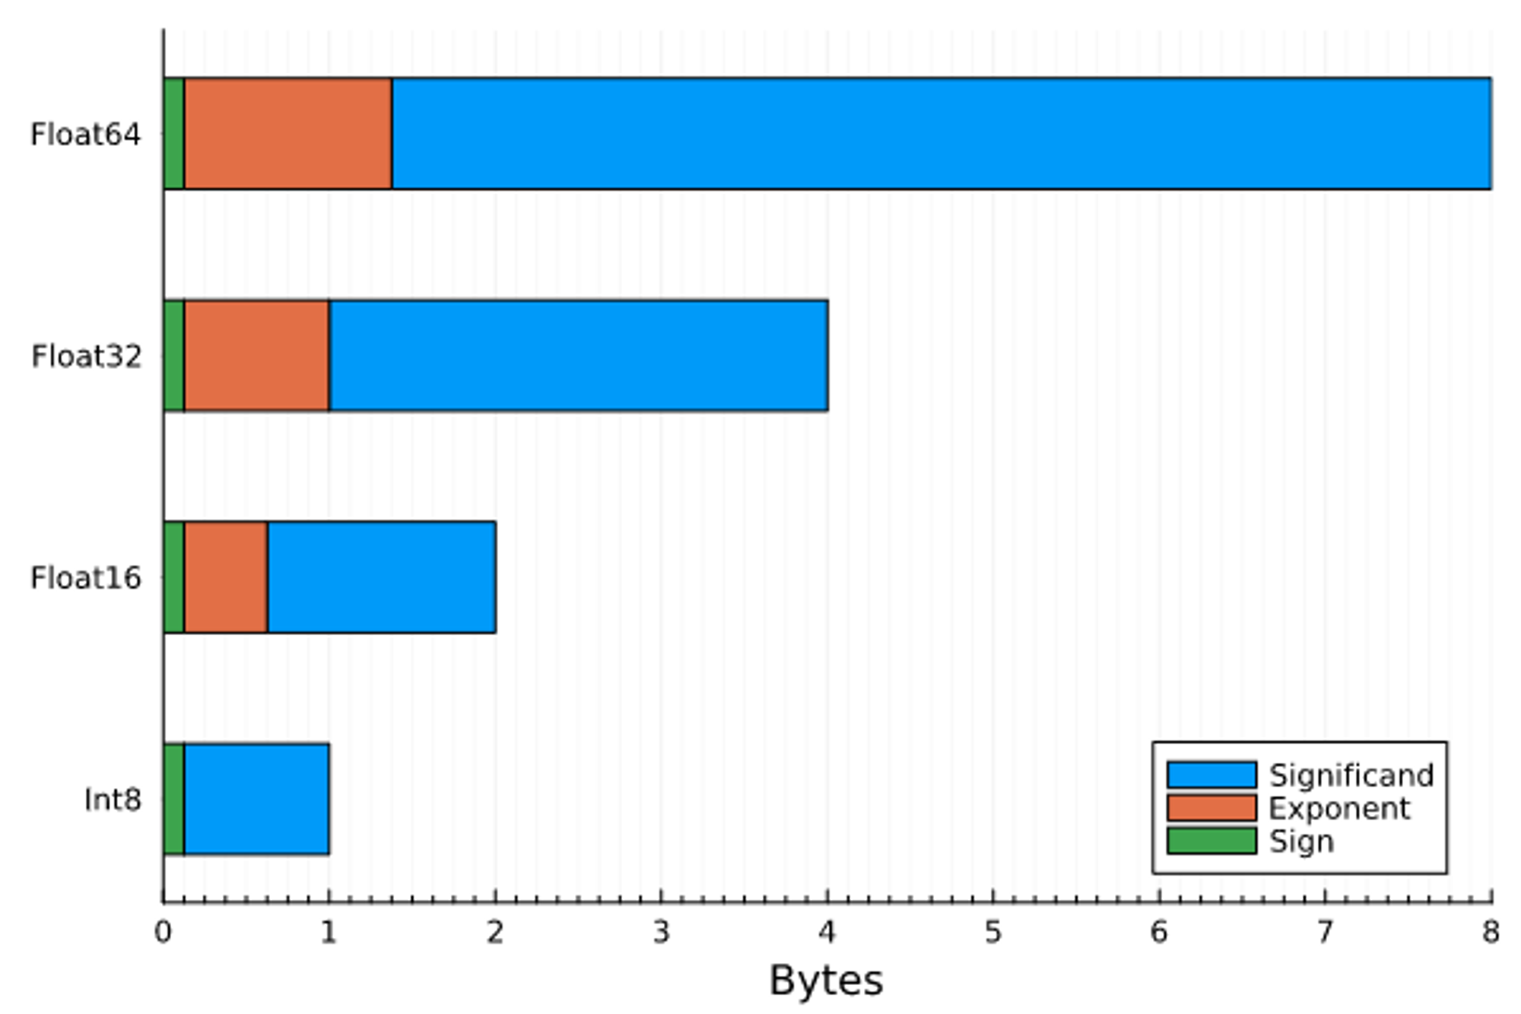
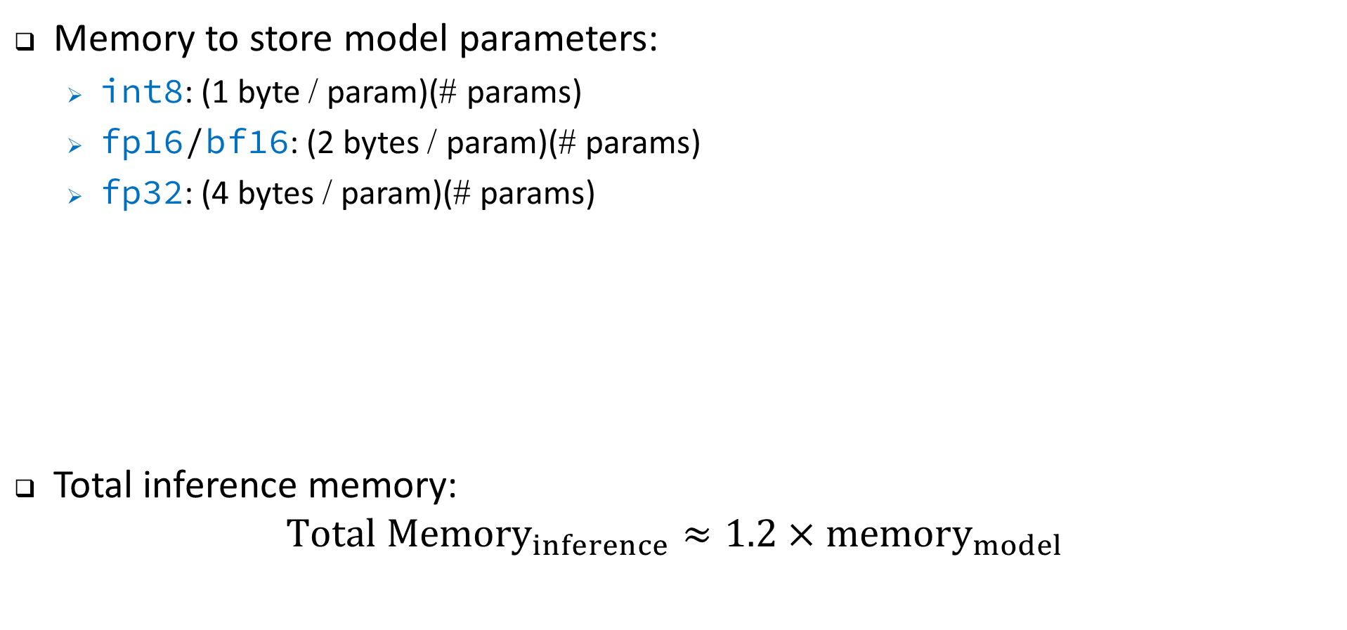
Inference Memory Requirement
Memory to store model parameters:
  int8: (1 byte / param)(# params)
  fp16/bf16: (2 bytes / param)(# params)
  fp32: (4 bytes / param)(# params)
Total inference memory:
$$Total {Memory}_{inference}≈1.2×memory_{model}$$
overhead

Slide 11
Training Memory Requirement
Total mem_{training} = mem_{model} + mem_{optimizer} + mem_{gradients} + mem_{activations}
Model memory requirement (mem_{model} ):
  Pure fp32: mem_{model}= (4 bytes / param)(# params)
  Pure fp16/bf16: mem_{model}= (2 bytes / param)(# params)
  Mixed precision training (fp16/bf16 and fp32):
    fp32 is stable but takes a lot of memory. It isn’t supported by tensor cores.
    fp16 is stable but difficult to converge. It enables us to use tensor cores.
    Mixed precision training retails two copies of a model. One in fp16/bf16 and another in fp32.
  (2 bytes / param)(# params) + (4 bytes / param)(# params)
This term will be counted as a part of optimizer state

Slide 12
Optimizer States Memory (mem_{optimizer})
Vanilla AdamW optimizer: (12 bytes/param)(# params)
  fp32 copy of parameters: 4 bytes/param
  Momentum: 4 bytes/param
  Variance: 4 bytes/param
SGD-like optimizers with momentum: (8 bytes/param)(# params)
  fp32 copy of parameters: 4 bytes/param
  Momentum: 4 bytes/param
8-bit optimizers (e.g., bitsandbytes): (6 bytes/param)(# params)
  fp32 copy of parameters: 4 bytes/param
  Momentum: 1 byte/param
  Variance: 1 byte/param
Notes:
Adam or Adaptive Moment Optimization
Momentum: accumulates the gradient of the past steps to determine the direction to go

Slide 13
Gradients Memory (mem_{gradients})
Gradients can be stored in fp32 or fp16.
  Usually they follow the model datatype.
fp32 training: (4 bytes/param)(# params)
fp16/mixed-precision training: (2 bytes/param)(# params)
Notes:
It is stored in fp16 for fp16 mixed-precision training.

Slide 14
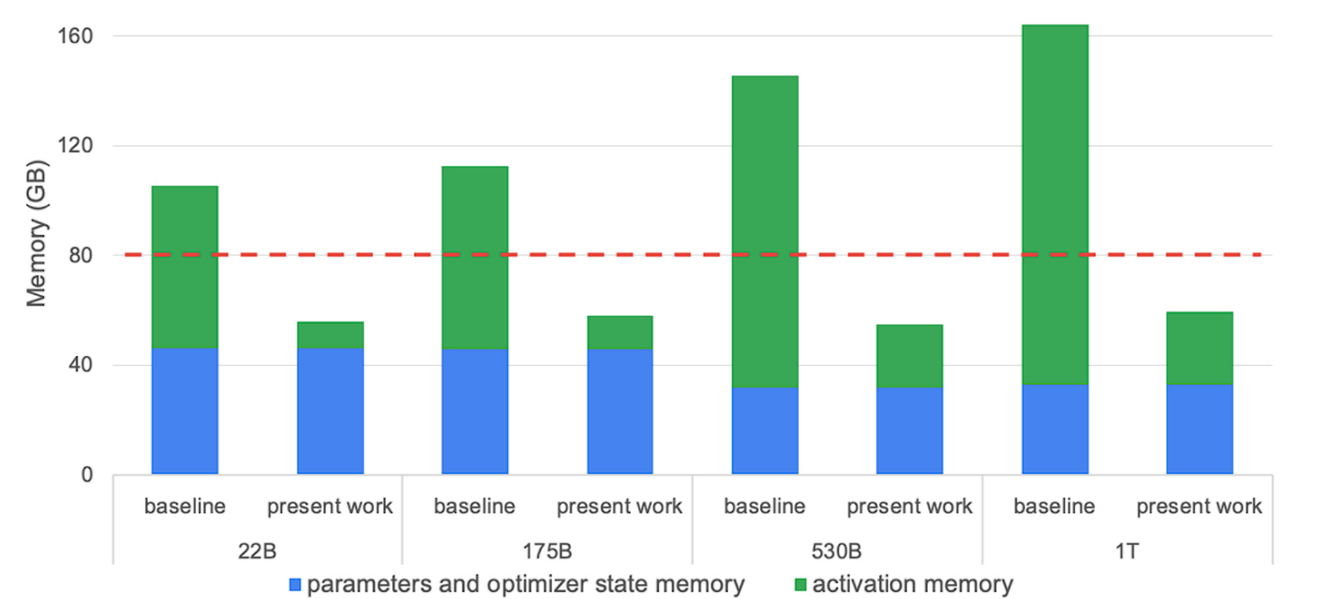
Activations Memory (mem_{activations})
Modern GPUs are typically bottlenecked by memory, not FLOPs, for LLM training.
Activation recomputation/checkpointing is a very popular method of trading reduced memory costs for extra compute costs.
V.A. Korthikanti et al, “Reducing activation recomputation in large transformer models,” Proceedings of Machine Learning and Systems 5 (2023).

Slide 15
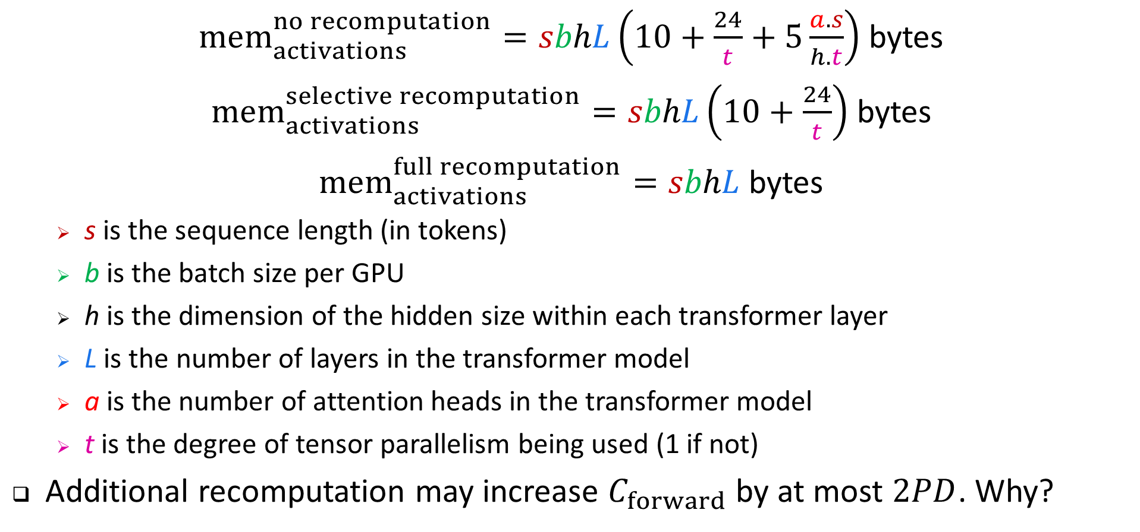
Activations Memory (mem_{activations}) – cont’d
$mem_{activations}^{no recomputation}=sbhL\left(10+\frac{24}{t}+5\frac{a.s}{h.t}\right)$ bytes
$mem_{activations}^{selective recomputation}=sbhL\left(10+\frac{24}{t}\right)$ bytes
$mem_{activations}^{full recomputation}=sbhL$ bytes
  s is the sequence length (in tokens)
  b is the batch size per GPU
  h is the dimension of the hidden size within each transformer layer
  L is the number of layers in the transformer model
  a is the number of attention heads in the transformer model
  t is the degree of tensor parallelism being used (1 if not)
Additional recomputation may increase $C_{forward}$ by at most $2PD$. Why?

Slide 16
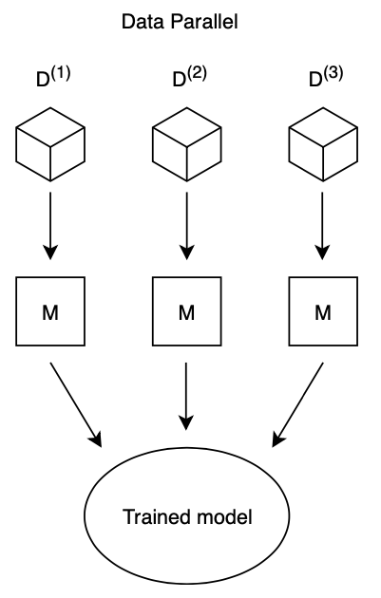
Data Parallel Approach
Data are partitioned among n worker nodes.
The same model is available to all worker nodes.
After that, gradients are calculated for each copy of the model, and then all the models exchange the gradients, which are subsequently averaged.
Can be used by most ML algorithm which assumes independent and identically distribution (i.i.d.) over the data samples.
  Can you name an algorithm which doesn’t make such assumption?
    Curriculum learning is a good example where data parallelism doesn’t work.

Slide 17
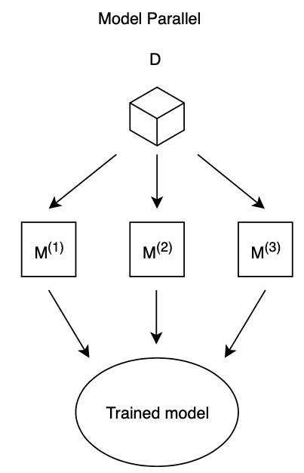
Model Parallelism Approach
Certain models are so big that cannot fit in a single node’s memory (e.g., GPU memory).
Model parallelism:
  Model is divided among all nodes.
  Each nodes processes an identical copy of the dataset.
Model parallelism is quite fast for large networks and very slow for small networks, while the opposite is true for data parallelism.
Model parallelism has lower communication overhead compared to data parallelism, but there’s no trick to hide communication required for synchronization of a network.

Slide 18
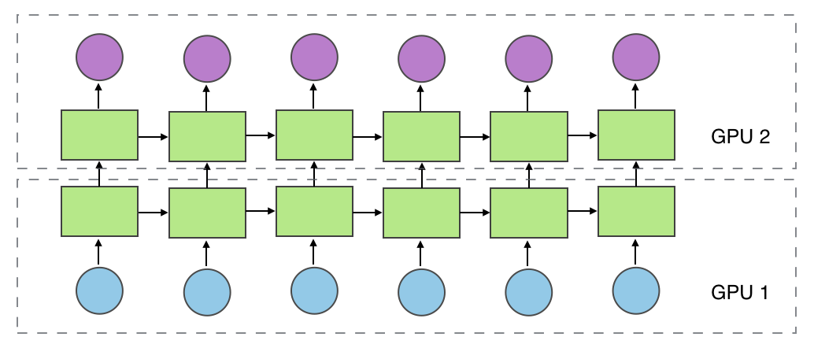
Model Parallelism Example
Each LSTM layer is assigned to a different GPU.
  After GPU 1 finishes computing layer 1 for the first sentence, it passes its output to GPU 2.
  At the same time, GPU 1 fetches the next sentence and starts training.
Is this really parallel?
  Maybe it should have been called “Model Serialization” or “Model Pipelining.”
Image source: https://mxnet.incubator.apache.org/versions/1.8.0/api/faq/model_parallel_lstm.html

